Slide 1








A 2-days National Level Hackathon on
AI in education
TechPulse
Shrigita Shinde
5-9-25
Sanjivani University, Kopargaon , Near Shirdi ,Ahilyanagar ,423601
www.samadhan.sistec.ac.in/

Slide 2


AREA OVERVIEW
Chosen Area: GATE exam preparation – one of the toughest competitive exams in India with 10+ lakh aspirants yearly.
Importance of AI: Helps simplify vast study material, create personalized study plans, and generate practice questions.
Potential Benefits: Provides an affordable 24×7 tutor, saves time, reduces stress, improves performance, and can scale to other competitive exam
IMPORTANCE OF AREA
: AI can bridge these gaps by making preparation smarter, affordable, and accessible to all.

Slide 3
Potential Challenges and Opportunities
Potential Challenges
Overwhelming study material, scattered across books/notes/videos.
Lack of personalized guidance & adaptive learning.
Difficulty in generating reliable GATE-style practice questions.
High stress & poor time management.
Opportunities
AI as a 24×7 personal tutor for students.
Affordable & scalable alternative to coaching centers.
Improved education quality through adaptive study plans.
Automation of content summarization, question generation & mock evaluation.
Expansion to other competitive exams beyond GATE.

Slide 4
Preliminary Solution Concept
AI-Powered GATE Exam Assistant designed to simplify preparation and reduce stress.
Capabilities:
Summarizes large study material into concise notes.
Generates GATE-style questions (MCQ, MSQ, numerical) with instant solutions.
Creates visual aids like flowcharts and formula sheets for quick revision.
Builds personalized study plans based on available time and progress.
Potential Impact: Smarter, faster, and more affordable preparation for students.

Slide 5
Key Features and Functionalities
Key Features and Functionalities
Smart Summarization – Converts textbooks, notes, and lectures into concise study material.
GATE-Style Q&A Generator – Auto-creates MCQs, MSQs, and numericals with instant solutions.
Visual Learning Tools – Generates flowcharts, mind maps, and formula sheets for quick revision.
Personalized Study Plans – Adaptive schedules based on available time & student progress.
Mock Test Evaluator – Simulates exam conditions with instant feedback & analytics.
24×7 AI Assistance – Always available for queries and guidance.
Multilingual Support – Helps students in English, Hindi, and regional languages.

Slide 6
Target Users and Expected Use Cases
Target Users
Students: Engineering graduates & final-year students preparing for GATE.
Working Professionals: Attempting GATE for PSU or higher studies.
Coaching Institutes & Tutors: To generate practice material and support students
.
Expected Use Cases
Students:
Upload notes/PDFs → get quick summaries & formula sheets.
Generate practice questions → attempt with instant feedback.
Receive personalized daily/weekly study plans.
Tutors/Institutes:
Create practice sets & visual aids quickly.
Track student progress & performance.

Slide 7
Data Requirements and Privacy Considerations
Data Needed: Notes, PDFs, past question papers, test scores, usage patterns.
Collection & Processing: Student uploads, open-source aggregation, anonymized logs.
Privacy & Security: Data encryption, user consent, no third-party sharing, GDPR/Indian law compliance.

Slide 8
AI Technologies and Methods
AI Technologies and Methods
Natural Language Processing (NLP) 🗣️
For summarizing study material, extracting key points, and answering student queries.
Machine Learning (ML) 🤖
To analyze student performance & recommend personalized study plans.
Recommendation Systems 🎯
Suggest targeted practice questions, revision notes, and resources.
Generative AI ✨
To create flowcharts, mind maps, and practice Q&A automatically.
Data Analysis & Pattern Recognition 📊
Identify weak areas, track progress, and provide smart insights

Slide 9
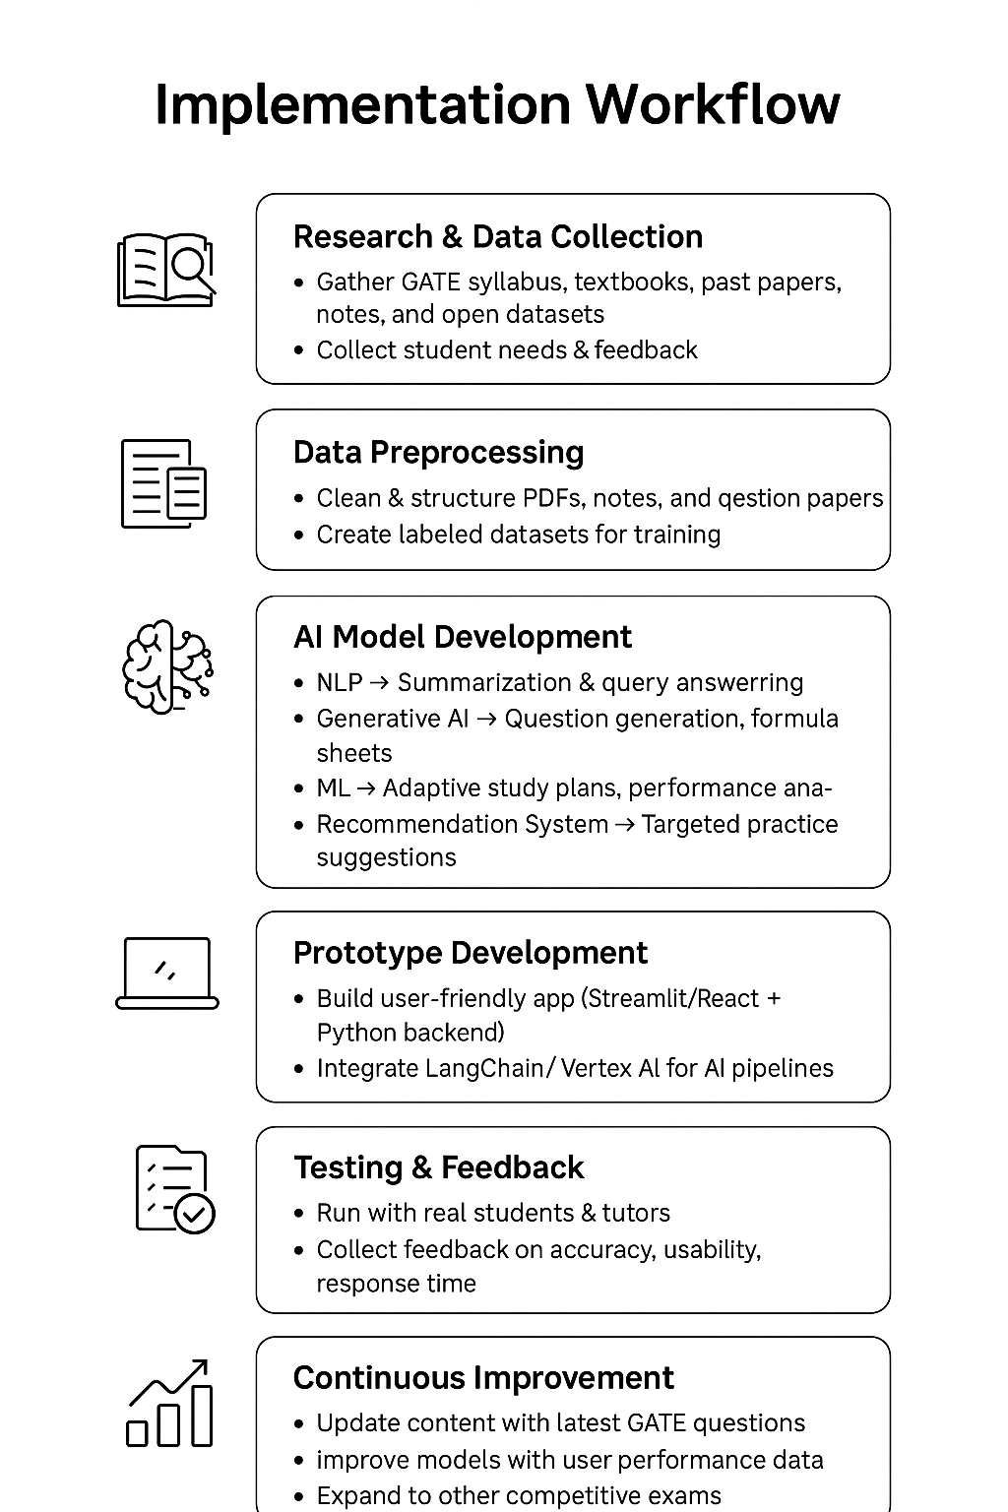
Implementation Approach
Phase 1 : Research needs, collect datasets, design system.
Phase 2 : Build prototype using Python, Vertex AI, PaLM, LangChain, Streamlit/React.
Phase 3 : Test with students, refine features & optimize.
Phase 4 : Deploy on Google Cloud/Firebase, scale, add multilingual, continuous updates.

Slide 10
Evaluation Metrics
Anticipated Impact
📉 Reduced stress & revision time.
📈 Improved student learning & retention.
😀 Higher satisfaction & exam confidence.
Key Metrics / KPIs
Accuracy → % of correct answers & summaries.
Response Time → Avg. time to generate answers (<3 sec).
Engagement → Daily Active Users (DAU), session duration.
Learning Outcome → Pre-test vs. post-test score improvement.
Satisfaction → Student feedback ratings (4★+).

